Slide 1
Sales Dataset Analysis
(Advanced Excel Project)
Name: Arunkumar A
Data Analytics & Data Science
Batch: August 2025

Slide 2
Project Objectives & Goals
• Analyze sales data to generate actionable business insights
• Track sales trends and growth opportunities
• Identify top-performing products and categories
• Study impact of discounts and returns
• Suggest data-driven performance improvements

Slide 3
Dataset Overview
• Superstore Sales Dataset
• 9,994 rows and 21 columns
• Includes order, customer, product, sales, discount & profit details
• Used for structured and time-based analysis

Slide 4
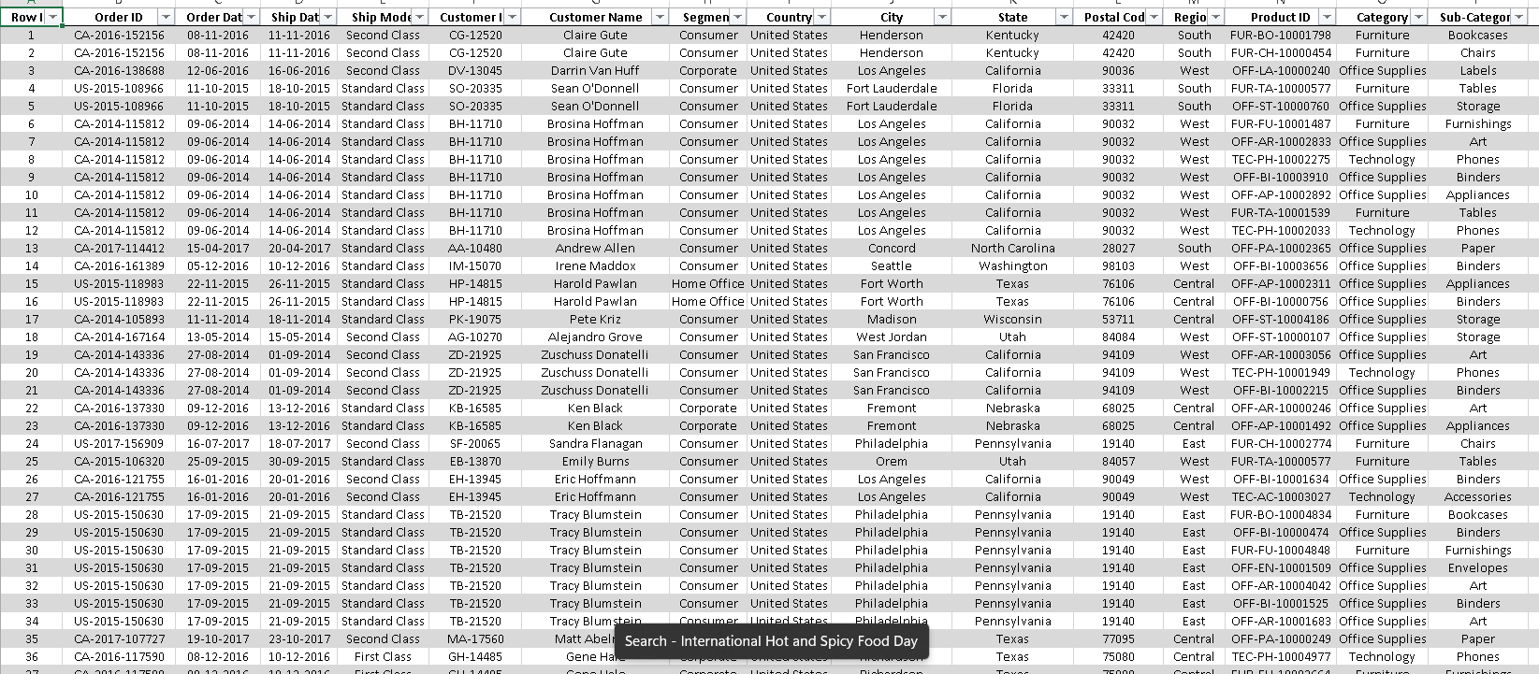
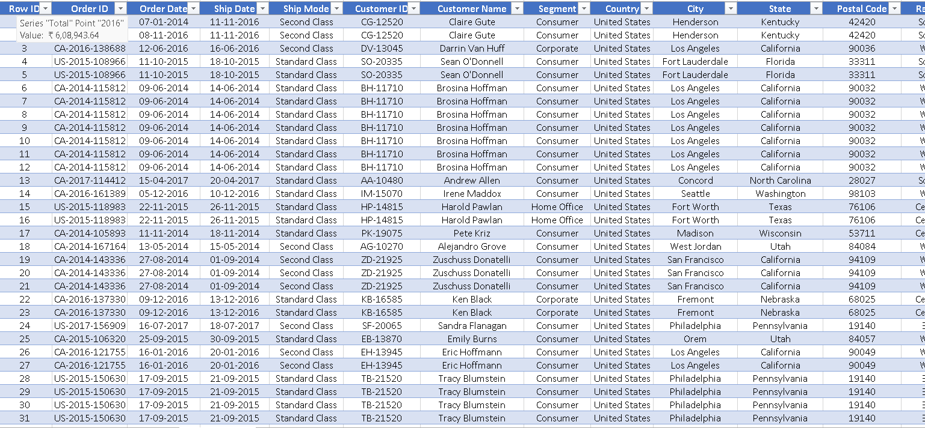
Data Cleaning & Preparation
• Removed duplicates and blank records
• Handled missing and inconsistent values
• Corrected negative values
• Standardized column names
• Applied proper date formatting
RAW DATA
CLEANED DATA

Slide 5
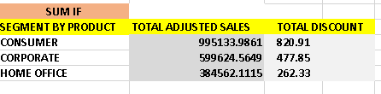
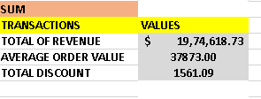
Key Metrics Calculated
• Total Revenue = SUM(Adjusted Sales)
• Total Orders Count
• Average Sales Value
• Total Discount Value
• Orders & Discounts using COUNTIF / AVERAGEIF

Slide 6
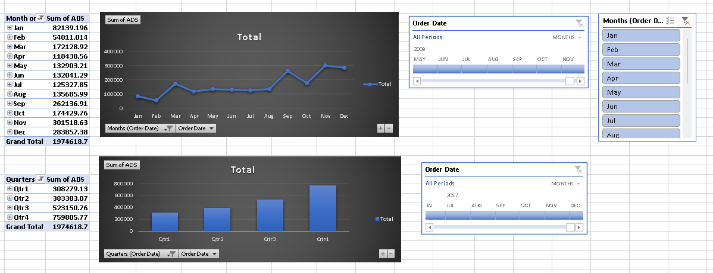
Pivot Tables – Analysis Approach
• Multi-dimensional sales analysis
• Grouping by product, channel & time
• Filtering for focused insights
• Identification of key revenue drivers

Slide 7
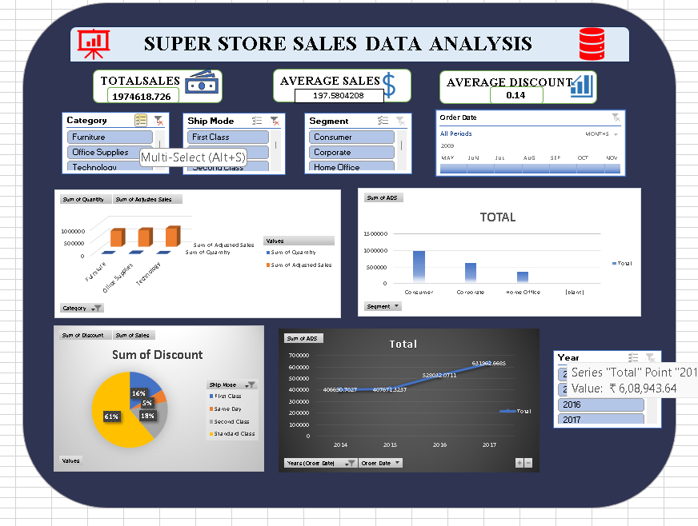
Dashboard Overview
• Interactive dashboard using Excel
• Visual KPIs and charts
• Dynamic filtering using slicers
• Quick business performance snapshot

Slide 8
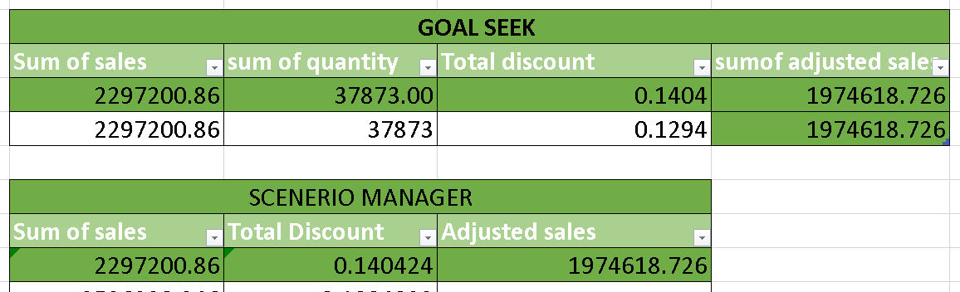
Goal Seek & Scenerio Manager

Slide 9
Business Recommendations
• Optimize discount strategies
• Promote slow-moving Furniture category
• Focus on high-demand tech products
• Improve customer loyalty programs

Slide 10
Conclusion & Next Steps
• Dashboard supports strategic decision-making
• Focus on pricing, delivery & customer loyalty
• Next Steps:
- Sales Forecasting
- Product Bundling
- Regional Analysis
- Discount Impact Study

